Slide 1
Simulation and Modeling
Lecture 10
Inventory System Analysis
Muhammad Mahbub Alam
Professor
CSE Department, IUT

Slide 2
SSQS – Computation Model
Conceptual Model
Specification Model
Computational Model
State Variables
Set of Events
Input Variables
Output Variables
State Equations
Output Equations
Input Data Modeling
State Equations
Output Equations
Input Data Modeling

Slide 3
Inventory System (IS): Performance Analysis
Problem Statement
Single product selling company
Demands come from customer
Satisfied immediately, if available
Periodically evaluated to place order
Arrival takes variable time
System is studied for a predefined time to
Minimize the average inventory cost

Slide 4
IS: Objectives and Goals
Study different inventory policies
To know the optimum inventory level
Maximum inventory capacity
Order placement threshold
To know the optimum average inventory cost
Average ordering cost
Average holding cost
Average shortage cost

Slide 5
Conceptual Model

Slide 6
IS: System Description (1/2)
System manages a single item
Demands of customers
Arrive at random interval
Demand amount is variable
If demanded items are available
Satisfied immediate
Otherwise, keeps backlog\
Inventory Evaluation
Periodic with fixed interval
Evaluation determines
Need of an order placement
available items < threshold
Amount of order
# of items should not exceed the capacity
Minimization of unused capacity

Slide 7
IS: System Description (2/2)
Order placement
Triggered by an evaluation
Determine ordering cost
Order Arrival
Takes a random time after order placement
Backlog is clear first
Remaining items are added to the inventory
Non-zero available items iif zero backlog
Period of study
Predefined number of months
No evaluation and order placement
Termination should occur before evaluation, if both have the same time occurrence

Slide 8
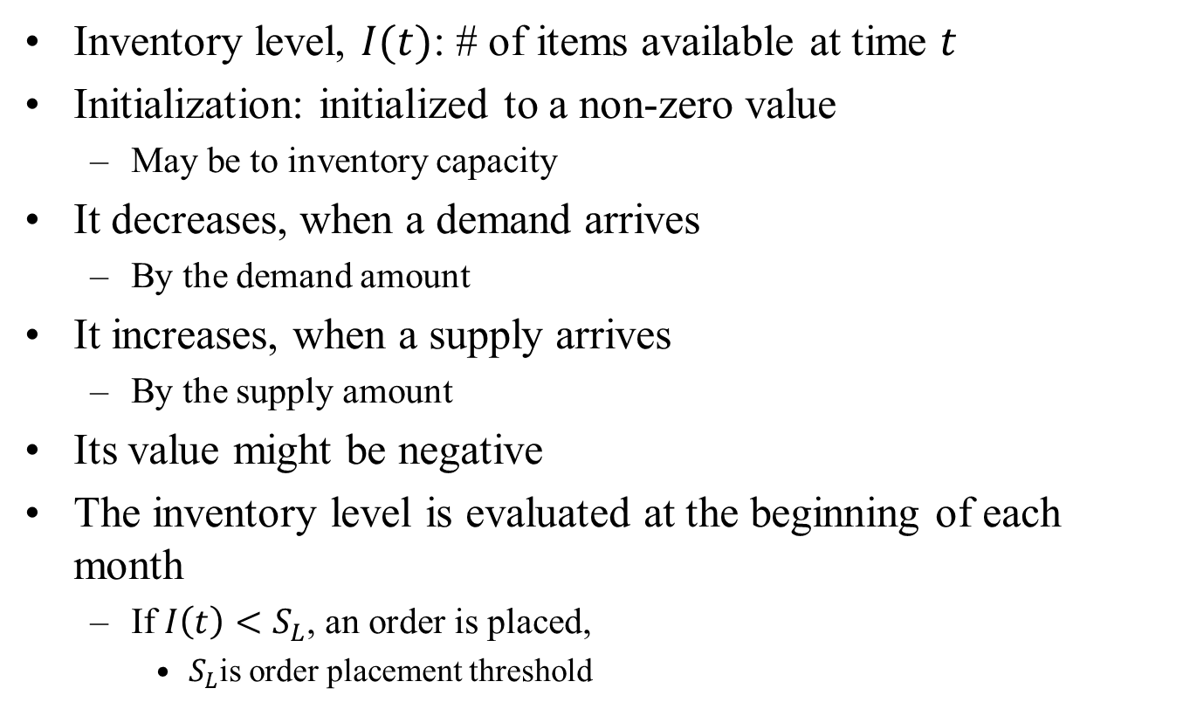
IS: State Variable(s)
Inventory level, $I(t)$: # of items available at time $t$
Initialization: initialized to a non-zero value
May be to inventory capacity
It decreases, when a demand arrives
By the demand amount
It increases, when a supply arrives
By the supply amount
Its value might be negative
The inventory level is evaluated at the beginning of each month
If $I\left(t\right)<S_{L}$, an order is placed,
$S_{L}$is order placement threshold

Slide 9
IS: Set of Events (1/3)
Evaluation of the Inventory level: Evaluation Event (e)
Does not directly affect system state
Evaluates whether an order is to be placed
Determine the order amount
Thus, triggers the order placement
Occurs after a fixed interval
Beginning at each month

Slide 10
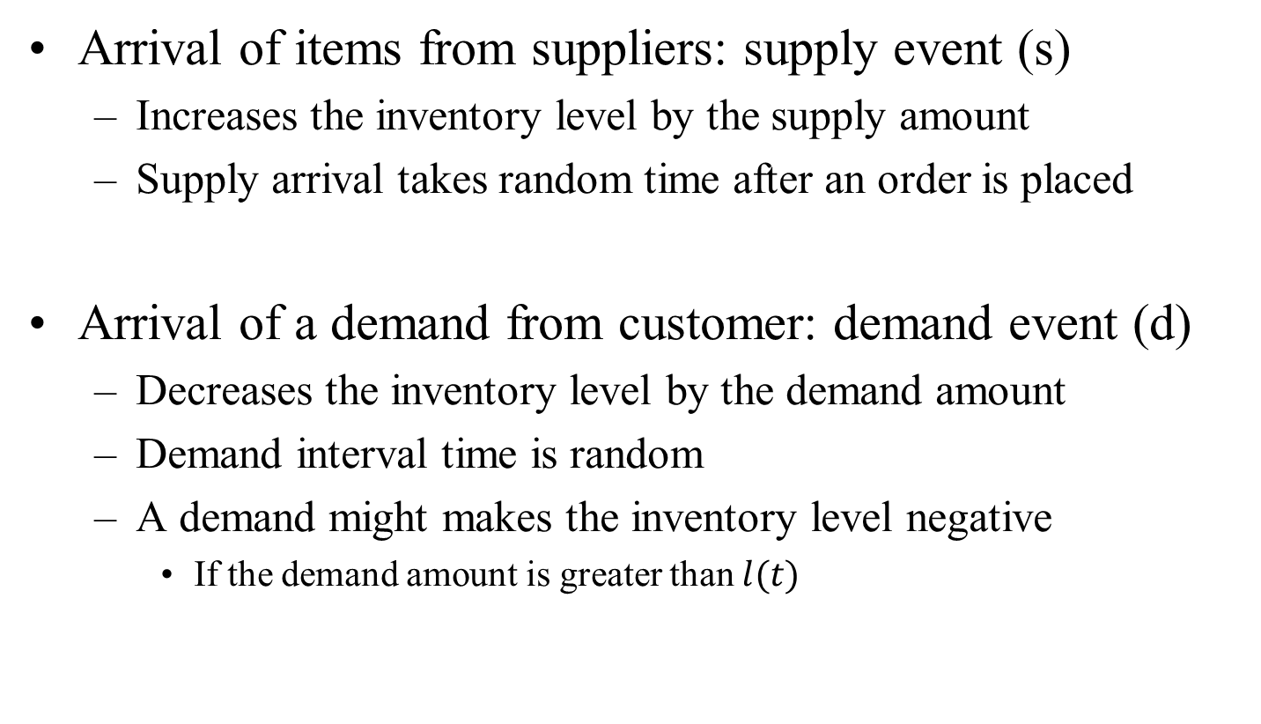
IS: Set of Events (2/3)
Arrival of items from suppliers: supply event (s)
Increases the inventory level by the supply amount
Supply arrival takes random time after an order is placed
Arrival of a demand from customer: demand event (d)
Decreases the inventory level by the demand amount
Demand interval time is random
A demand might makes the inventory level negative
If the demand amount is greater than $l(t)$

Slide 11
IS: Set of Events (3/3)
Reaching the termination time: termination event (t)
Ends the simulation
Occurs only once in a simulation run
Forces the system to stop immediately
Cancel all events from the event list
Careful selection is necessary to allow this event to occur before event e
No need to evaluate the system and place an order if it ends immediately

Slide 12
IS: Input and Output Variables (1/2)
Input variables:
Evaluation Interval
Demand arrival interval
Supply arrival interval
Simulation termination time
Maximum inventory level
Order placement threshold

Slide 13
IS: Input and Output Variables (2/2)
Output Variables
Average inventory cost
Job-average output variable
Average ordering cost
Total ordering cost
Time-average output variable
Average holding cost
Holding area
Average shortage cost
Shortage area

Slide 14
Specification Model

Slide 15
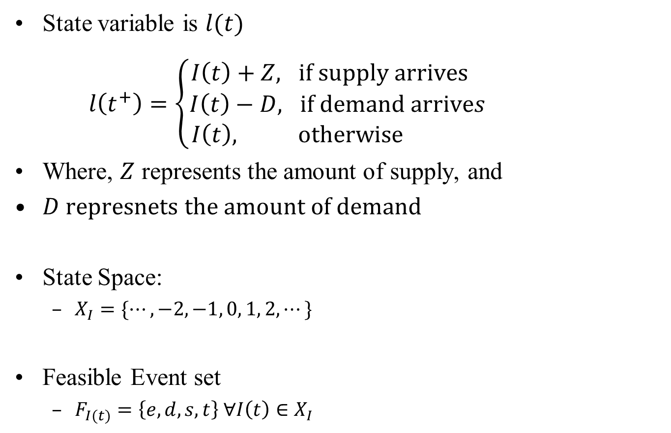
IS: State Equation
State variable is $l(t)$
$l\left(t^{+}\right)=\left\{\begin{aligned}I\left(t\right)+Z, if supply arrives \\ &I\left(t\right)−D, if demand arrives \\ I\left(t\right), otherwise \end{aligned}\right.$
Where, $Z$ represents the amount of supply, and
$D represnets the amount of demand$
State Space:
$X_{I}=\{⋯, −2, −1, 0, 1, 2, ⋯\}$
Feasible Event set
$F_{I(t)}=\left\{e,d, s, t\right\} ∀I\left(t\right)∈X_{I}$

Slide 16
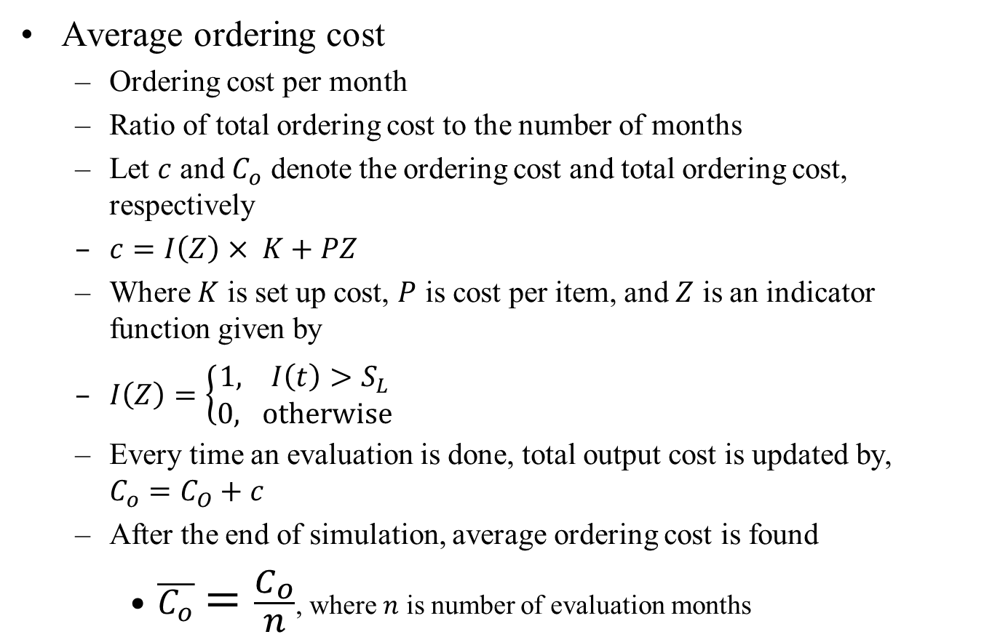
IS: Output Equations (1/4)
Average ordering cost
Ordering cost per month
Ratio of total ordering cost to the number of months
Let $c$ and $C_{o}$ denote the ordering cost and total ordering cost, respectively
$c=I\left(Z\right)× K+PZ$
Where $K$ is set up cost, $P$ is cost per item, and $Z$ is an indicator function given by
$I\left(Z\right)=\left\{\begin{aligned}1, I\left(t\right)>S_{L} \\ &0, otherwise\end{aligned}\right.$
Every time an evaluation is done, total output cost is updated by, $C_{o}=C_{O}+c$
After the end of simulation, average ordering cost is found
$\overline{C_{o}}=\frac{C_{o}}{n}$, where $n$ is number of evaluation months

Slide 17
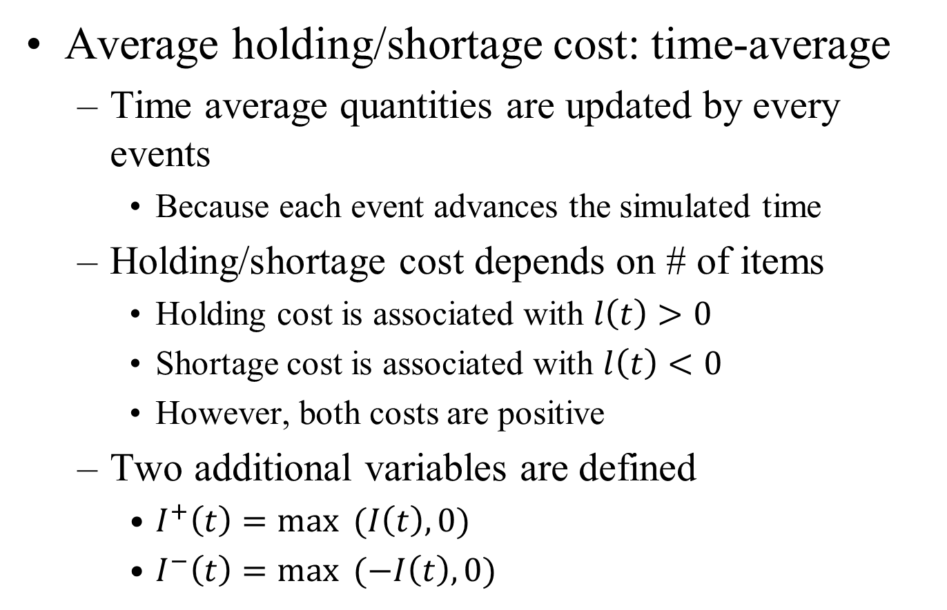
IS: Output Equations (2/4)
Average holding/shortage cost: time-average
Time average quantities are updated by every events
Because each event advances the simulated time
Holding/shortage cost depends on # of items
Holding cost is associated with $l\left(t\right)>0$
Shortage cost is associated with $l\left(t\right)<0$
However, both costs are positive
Two additional variables are defined
$I^{+}\left(t\right)=\max{ (I\left(t\right), 0)}$
$I^{−}\left(t\right)=\max{ (−I\left(t\right), 0)}$

Slide 18
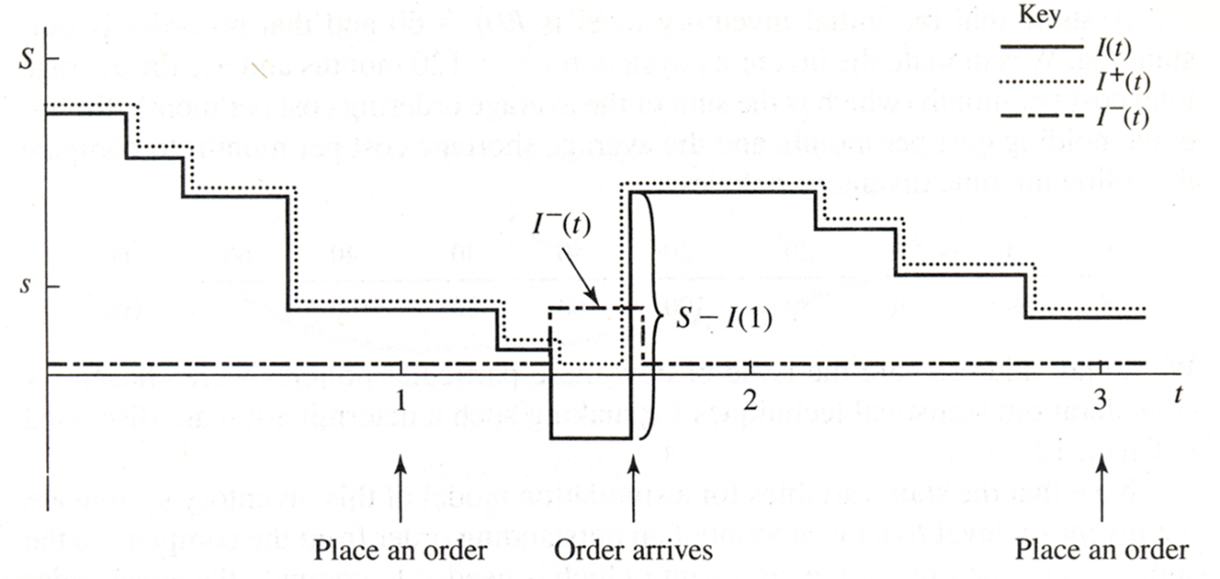
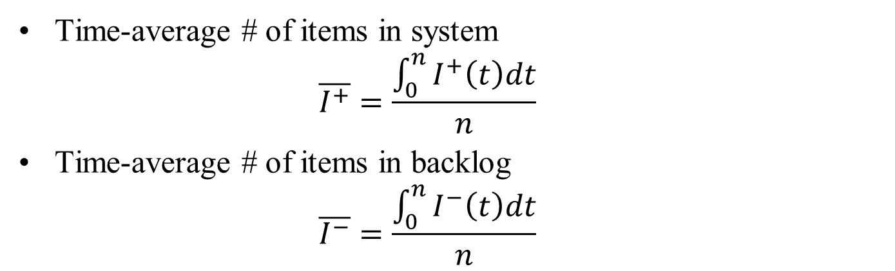
IS: Output Equations (3/4)
Time-average # of items in system
$$\overline{I^{+}}=\frac{\int_{0}^{n}{I^{+}\left(t\right)dt}}{n}$$
Time-average # of items in backlog
$$\overline{I^{−}}=\frac{\int_{0}^{n}{I^{−}\left(t\right)dt}}{n}$$

Slide 19
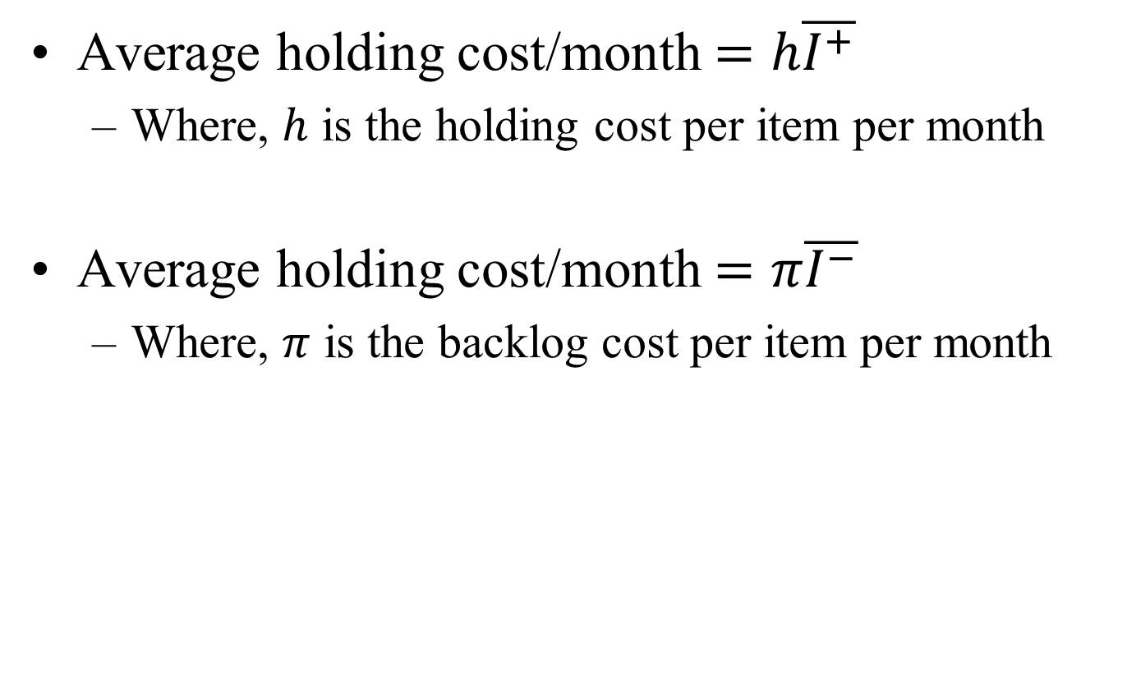
IS: Output Equations (4/4)
Average holding cost/month $=h\overline{I^{+}}$
Where, $h$ is the holding cost per item per month
Average holding cost/month $=π\overline{I^{−}}$
Where, $π$ is the backlog cost per item per month

Slide 20
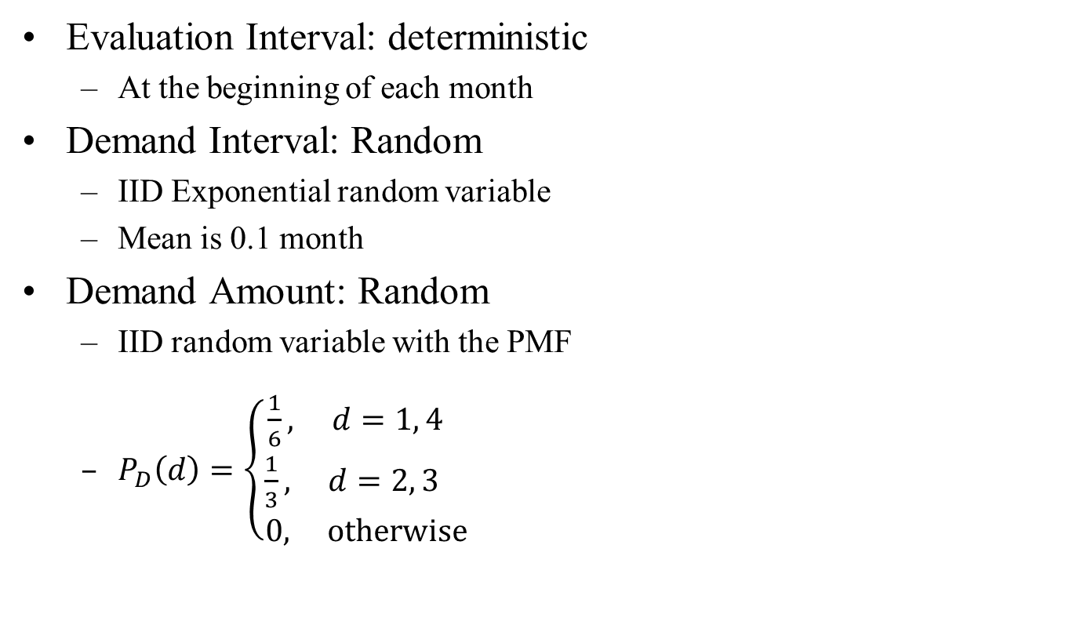
IS: Input Data Modeling (1/2)
Evaluation Interval: deterministic
At the beginning of each month
Demand Interval: Random
IID Exponential random variable
Mean is 0.1 month
Demand Amount: Random
IID random variable with the PMF
$P_{D}\left(d\right)=\left\{\begin{aligned}\frac{1}{6}, d=1, 4 \\ \frac{1}{3}, d=2, 3 \\ 0, otherwise\end{aligned}\right.$

Slide 21
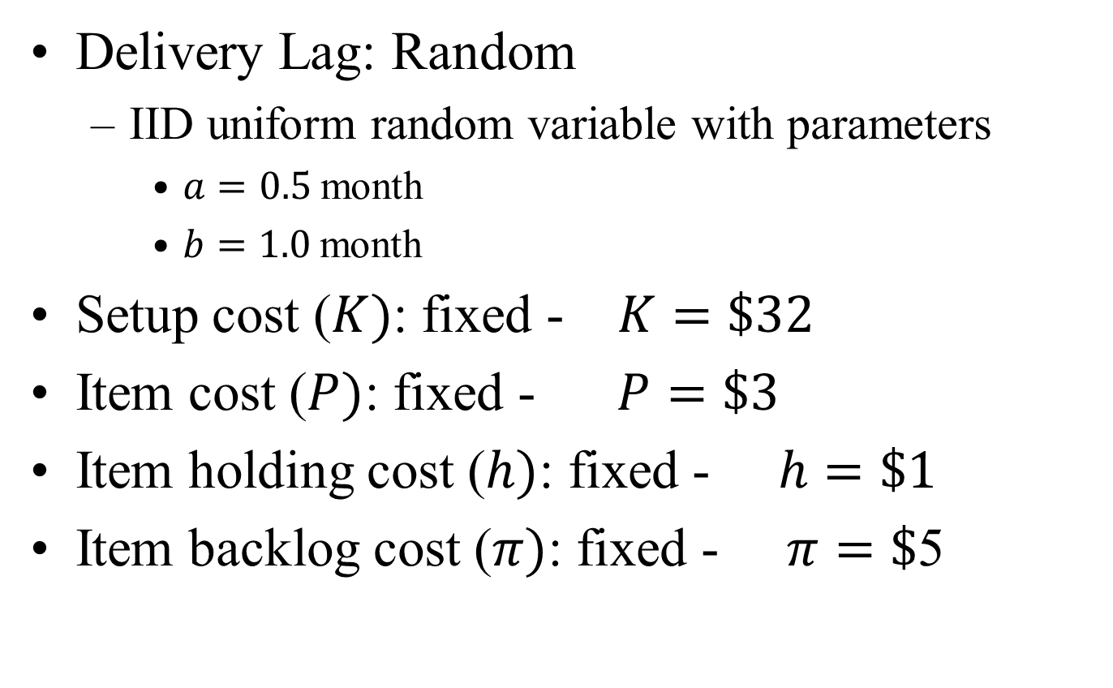
IS: Input Data Modeling (1/2)
Delivery Lag: Random
IID uniform random variable with parameters
$a=0.5$month
$b=1.0$month
Setup cost ($K)$: fixed - $K=\$32$
Item cost ($P)$: fixed - $P=\$3$
Item holding cost ($h)$: fixed - $h=\$1$
Item backlog cost ($π)$: fixed - $π=\$$5

Slide 22
Computational Model

Slide 23
IS: Scheduling (Run function)

Slide 24
IS: Events

Slide 25
IS: Inventory Initialize Method

Slide 26
IS: Supply Handler

Slide 27

IS: Demand Handler
$$P_{D}\left(d\right)=\left\{\begin{aligned}\frac{1}{6}, d=1, 4 \\ \frac{1}{3}, d=2, 3 \\ 0, otherwise\end{aligned}\right.$$

Slide 28
IS: Evaluation Handler

Slide 29
IS: Termination Handler

Slide 30
IS: Update Statistical Variables

Slide 31
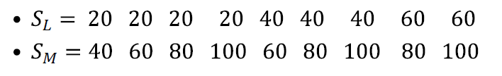
Different Policies

